Slide 1
CHƯƠNG TRÌNH ĐÀO TẠO NHÂN VIÊN
MÔN HỌC: CSS
SASS
Trình bày: Team Sass
HANOI – JUN, 2015
6/15/15
www.qsoftvietnam.com
1
Notes:
1

Slide 2

6/15/15
www.qsoftvietnam.com
2

Slide 3
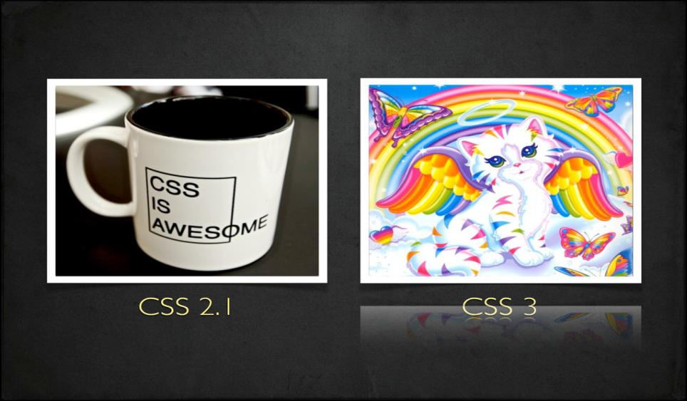
6/15/15
www.qsoftvietnam.com
3

Slide 4
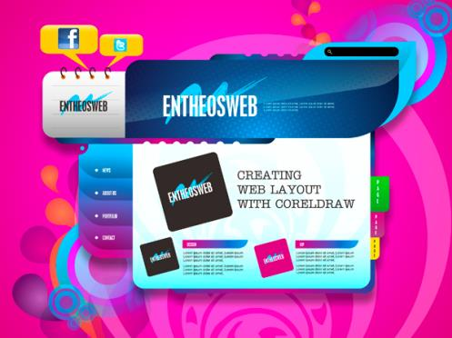
Good Speed
Work on my phone
Wow, 3D animation!
New Fonts
Multiple browser support
Colorful
Unbelievable
What they see
6/15/15
www.qsoftvietnam.com
4

Slide 5
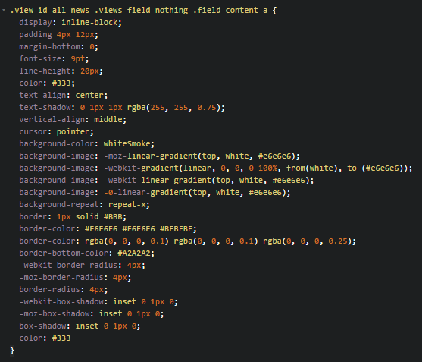

What we see
Too complex, too long
Difficult to maintain
What if customer want to change a color in project?
Ctrl + R => replace all?
6/15/15
www.qsoftvietnam.com
5

Slide 6
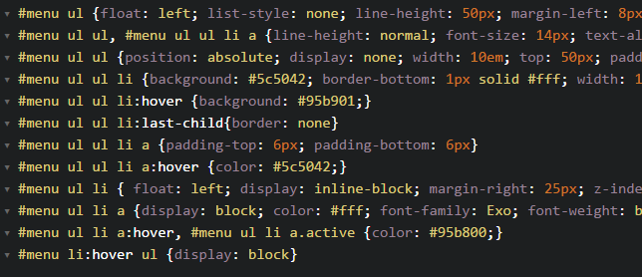
Dupplicate, hard to read
6/15/15
www.qsoftvietnam.com
6

Slide 7
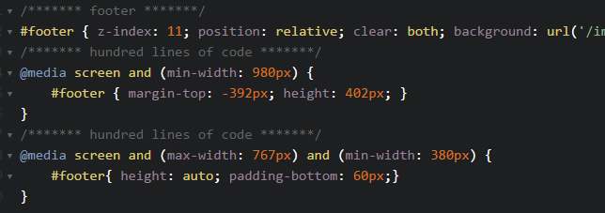
Waste of time
6/15/15
www.qsoftvietnam.com
7

Slide 8
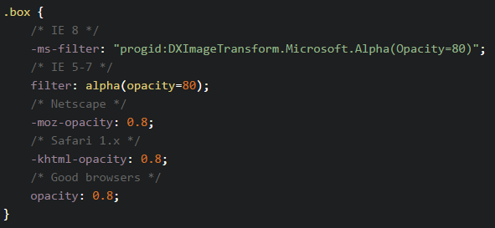
Hard to implement
6/15/15
www.qsoftvietnam.com
8

Slide 9
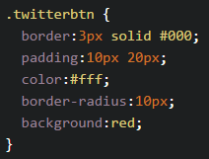
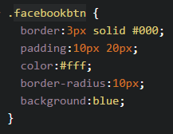


No re-use, just copy & paste
6/15/15
www.qsoftvietnam.com
9

Slide 10
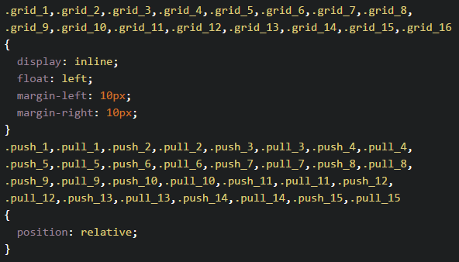
Oh my god, no looping function
6/15/15
www.qsoftvietnam.com
10

Slide 11
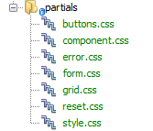
Separate CSS are good enough?
=> HTTP requests problem
6/15/15
www.qsoftvietnam.com
11

Slide 12
What we need?
Easy to change/maintain (Variable)
Easy to read (Nesting)
Easy to write (Mixins)
No duplicate, reusable code (Extend/Inheritance)
Easy to organize, fewer requests (Partials, Import)
Powerful (Operators, Condition, Loop)
6/15/15
www.qsoftvietnam.com
12

Slide 13

Introduction to
6/15/15
www.qsoftvietnam.com
13

Slide 14
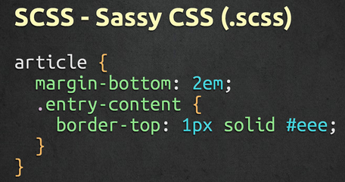
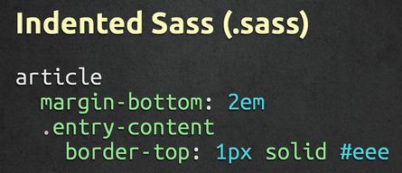
What is Sass
Syntactically Awesome StyleSheets
Simple but powerful syntax for creating manageable CSS
Too “flavors” – SASS & SCSS
6/15/15
www.qsoftvietnam.com
14

Slide 15
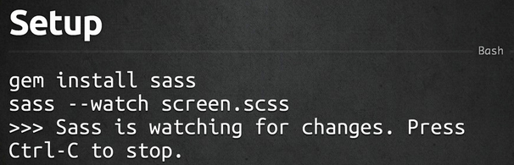
How to install
6/15/15
www.qsoftvietnam.com
15

Slide 16

Sass work flow
6/15/15
www.qsoftvietnam.com
16

Slide 17

6/15/15
www.qsoftvietnam.com
17

Slide 18
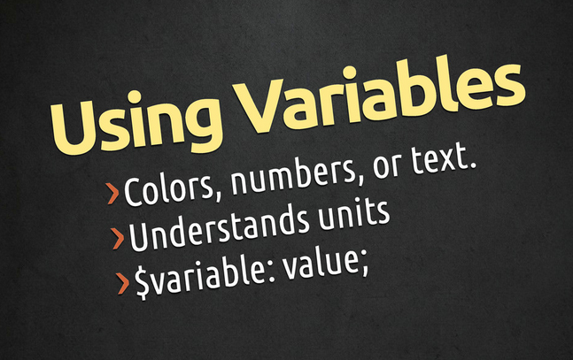
6/15/15
www.qsoftvietnam.com
18

Slide 19
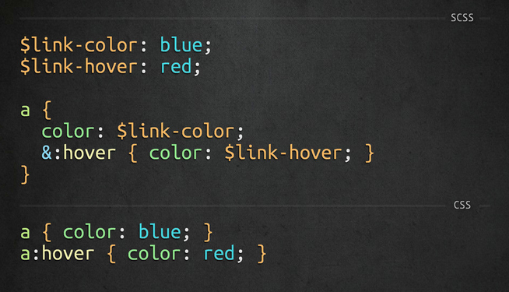
6/15/15
www.qsoftvietnam.com
19

Slide 20

6/15/15
www.qsoftvietnam.com
20

Slide 21
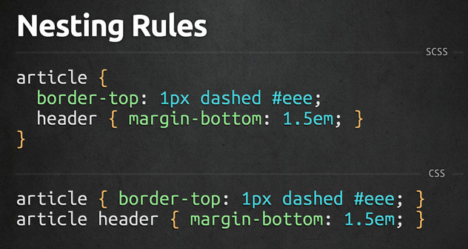
6/15/15
www.qsoftvietnam.com
21

Slide 22
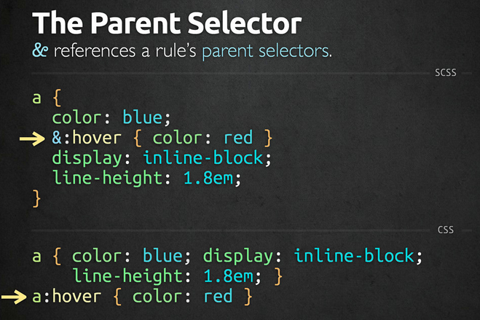
6/15/15
www.qsoftvietnam.com
22

Slide 23
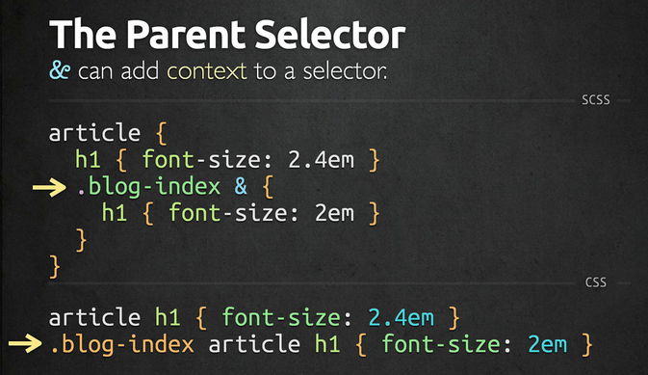
6/15/15
www.qsoftvietnam.com
23

Slide 24
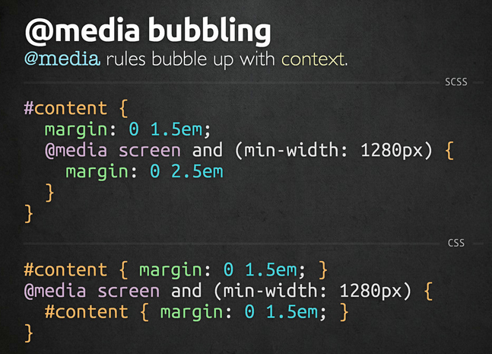
6/15/15
www.qsoftvietnam.com
24

Slide 25

6/15/15
www.qsoftvietnam.com
25

Slide 26
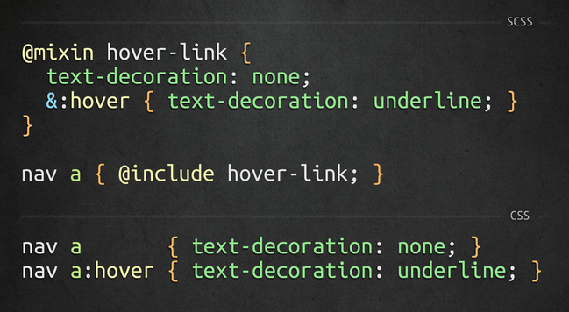
6/15/15
www.qsoftvietnam.com
26

Slide 27
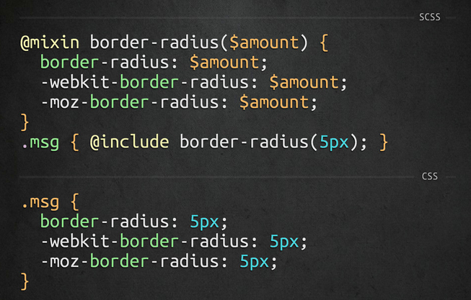
6/15/15
www.qsoftvietnam.com
27

Slide 28
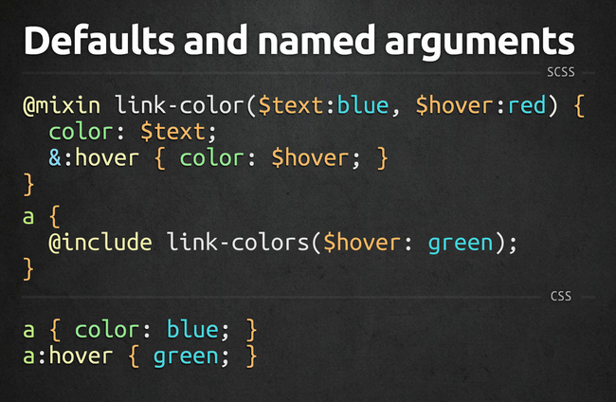
6/15/15
www.qsoftvietnam.com
28

Slide 29

6/15/15
www.qsoftvietnam.com
29

Slide 30
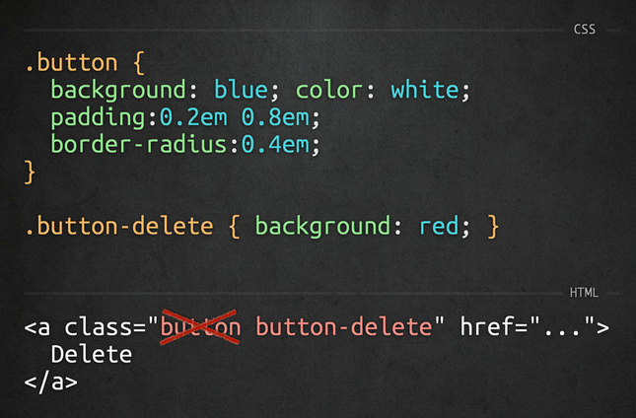
6/15/15
www.qsoftvietnam.com
30

Slide 31
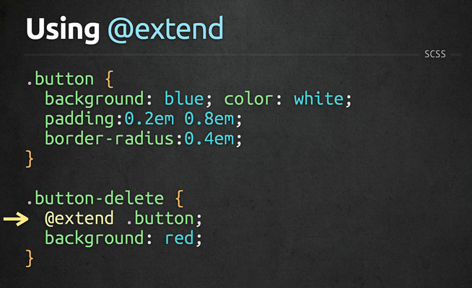
6/15/15
www.qsoftvietnam.com
31

Slide 32
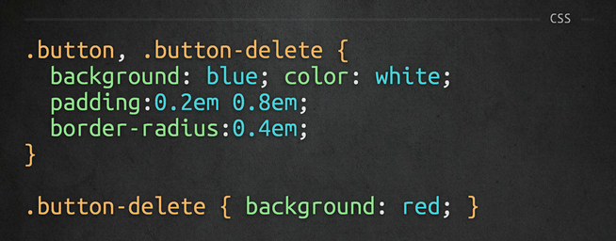
6/15/15
www.qsoftvietnam.com
32

Slide 33

6/15/15
www.qsoftvietnam.com
33

Slide 34
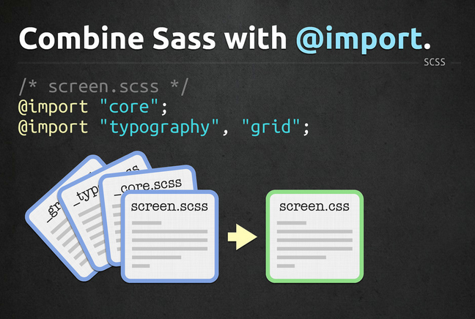
6/15/15
www.qsoftvietnam.com
34

Slide 35
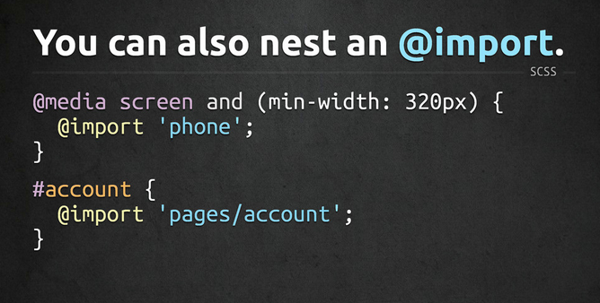
6/15/15
www.qsoftvietnam.com
35

Slide 36

6/15/15
www.qsoftvietnam.com
36

Slide 37
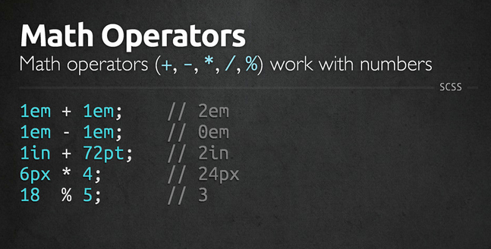
6/15/15
www.qsoftvietnam.com
37

Slide 38
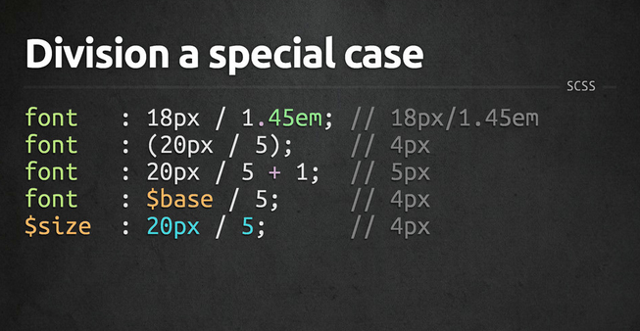
6/15/15
www.qsoftvietnam.com
38

Slide 39
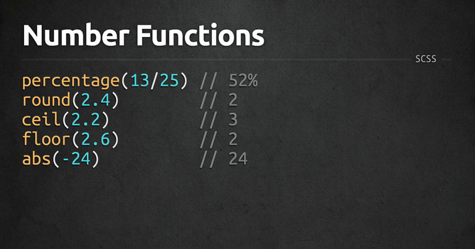
6/15/15
www.qsoftvietnam.com
39

Slide 40
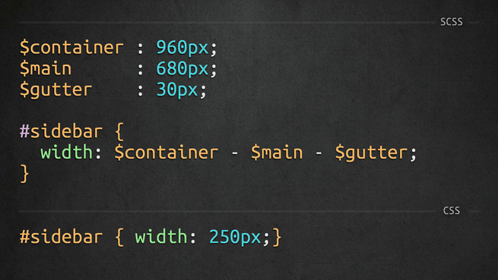
6/15/15
www.qsoftvietnam.com
40

Slide 41

6/15/15
www.qsoftvietnam.com
41

Slide 42

6/15/15
www.qsoftvietnam.com
42

Slide 43
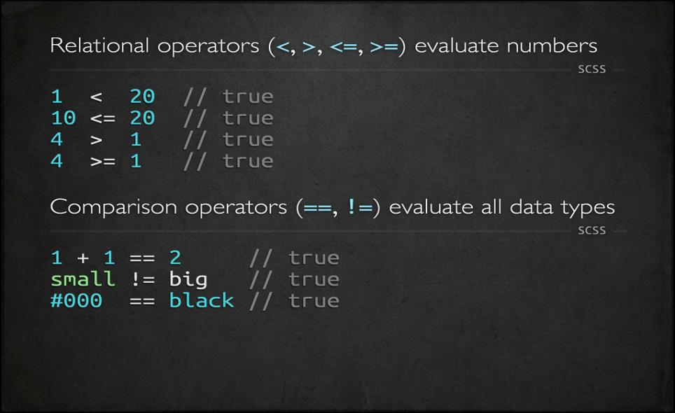
6/15/15
www.qsoftvietnam.com
43

Slide 44
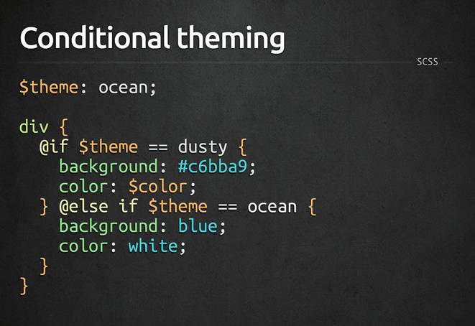
6/15/15
www.qsoftvietnam.com
44

Slide 45
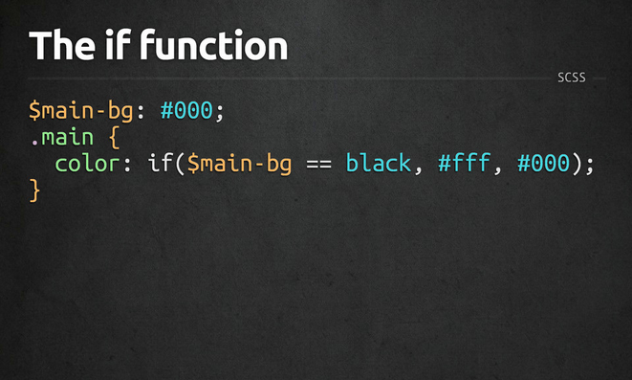
6/15/15
www.qsoftvietnam.com
45

Slide 46
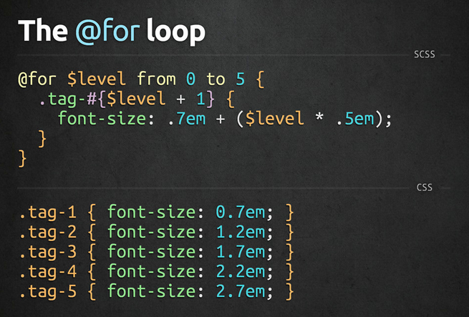
6/15/15
www.qsoftvietnam.com
46

Slide 47
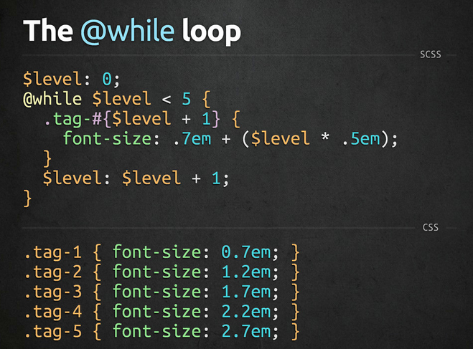
6/15/15
www.qsoftvietnam.com
47

Slide 48
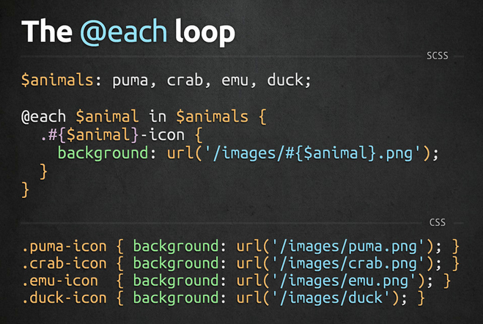
6/15/15
www.qsoftvietnam.com
48

Slide 49

6/15/15
www.qsoftvietnam.com
49

Slide 50
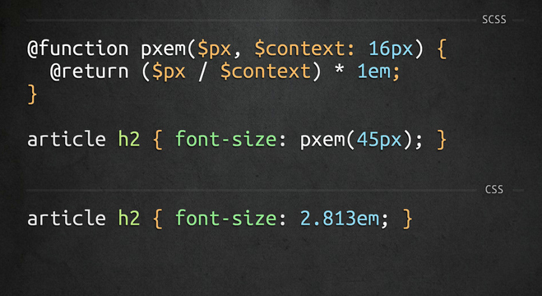
6/15/15
www.qsoftvietnam.com
50

Slide 51

Introduction to
6/15/15
www.qsoftvietnam.com
51
Notes:
http://compass-style.org/reference/compass/css3/
51

Slide 52
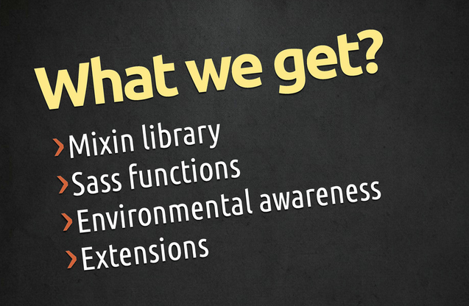
6/15/15
www.qsoftvietnam.com
52

Slide 53
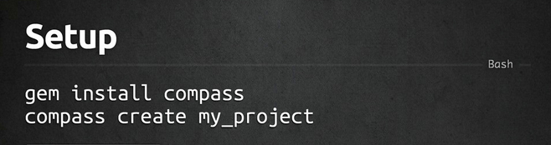
How to install
6/15/15
www.qsoftvietnam.com
53

Slide 54
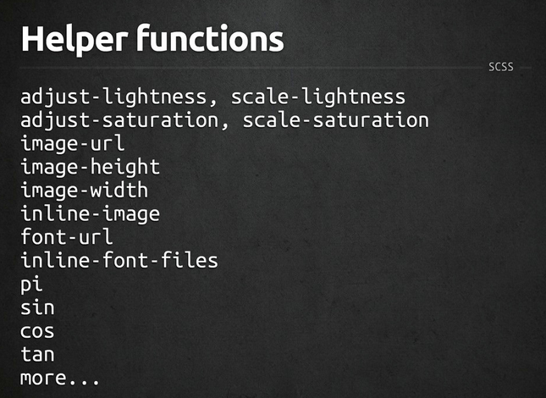
6/15/15
www.qsoftvietnam.com
54

Slide 55
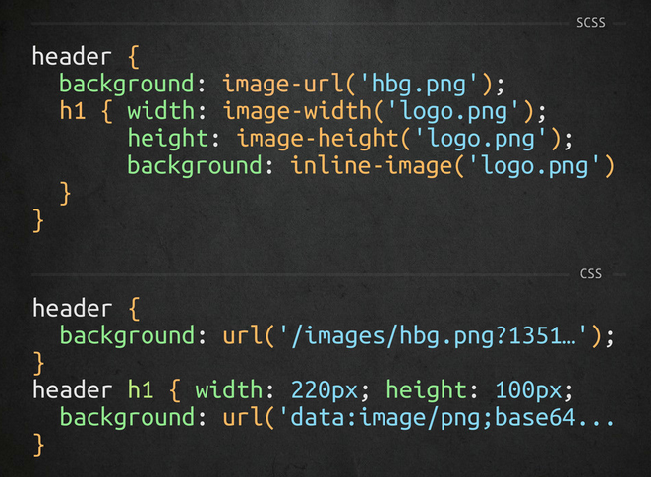
6/15/15
www.qsoftvietnam.com
55

Slide 56
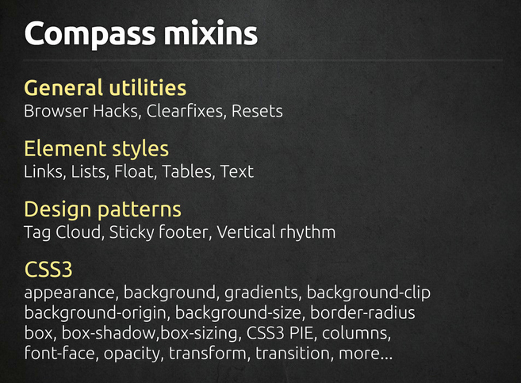
6/15/15
www.qsoftvietnam.com
56

Slide 57
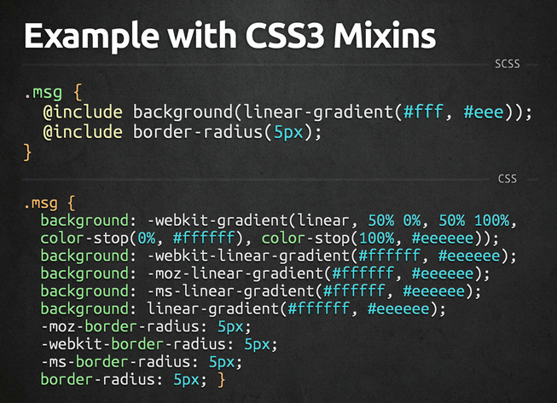
6/15/15
www.qsoftvietnam.com
57

Slide 58
Disadvantages
Not for beginners:
Need basic CSS, time to understand SASS
Need basic programming knowledge (problem for designer)
Need installation/environment setup
Need time to compile
A little bit hard to debug
Can’t edit on live server (nah, you shouldn’t do that)
6/15/15
www.qsoftvietnam.com
58

Slide 59
Sass Tools
Prepros
Livereload
Hammer
Koala
Scout
Bourbon
6/15/15
www.qsoftvietnam.com
59

Slide 60
Sass Tools
Compile SASS to CSS
Add mixins, functions, helpers
Add compass, autoPrefix, SourceMaps
Output style: Compressed, Compact, Nested, Expended
6/15/15
www.qsoftvietnam.com
60

Slide 61
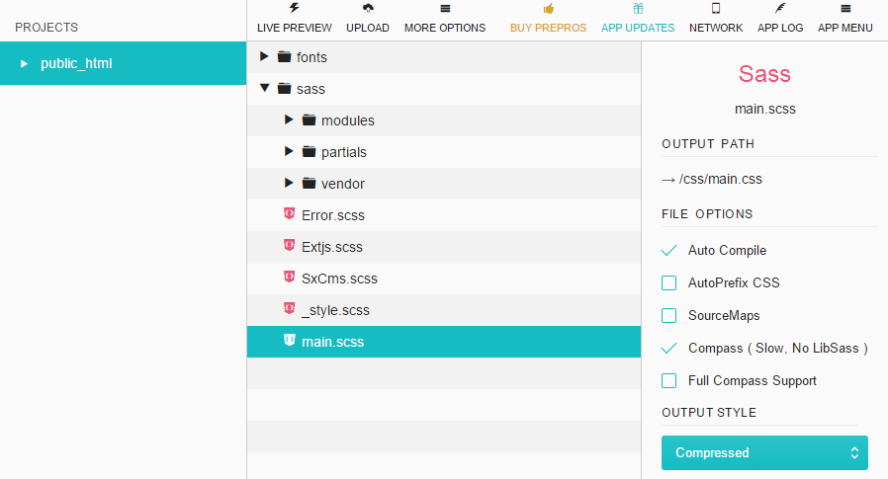
6/15/15
www.qsoftvietnam.com
61

Slide 62
Sass Best Practices
Nest only when necessary
No more than 4 levels deep
Before writing a custom mixin, look for it in compass
http://compass-style.org/reference/compass/css3/
Variable naming convention ${modifer(s)}-{name}
$link-color, $dark-link-color, $large-border-radius
Don’t reduce mixin usage, use params input
Extend is better than mixin
Notes:
http://codepen.io/quangsonpro/public-titles-asc/

Slide 63
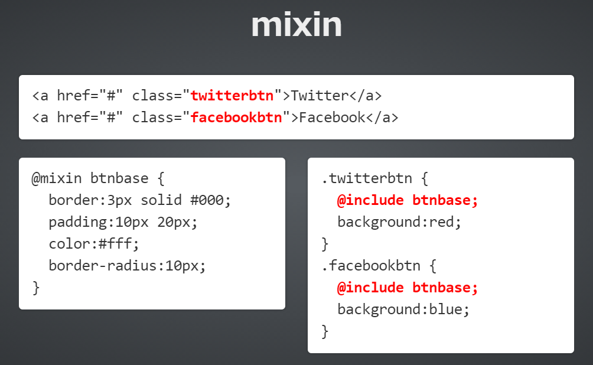
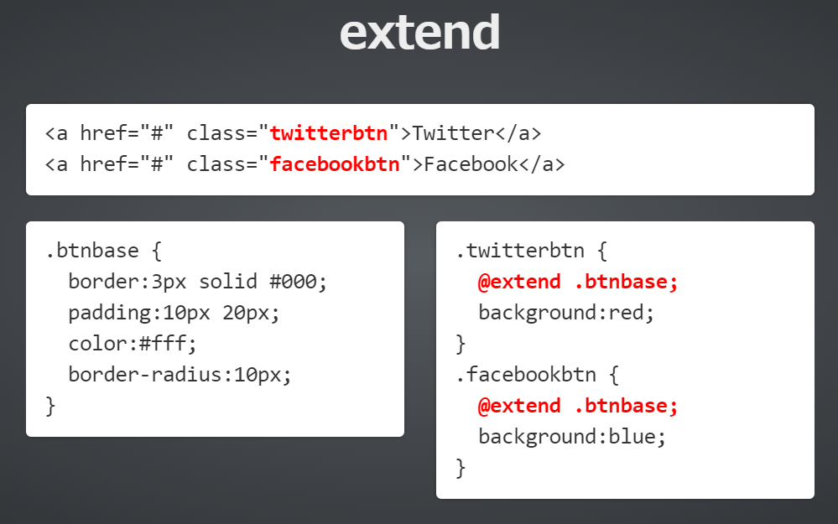
Sass Best Practices
Notes:
http://codepen.io/quangsonpro/public-titles-asc/

Slide 64
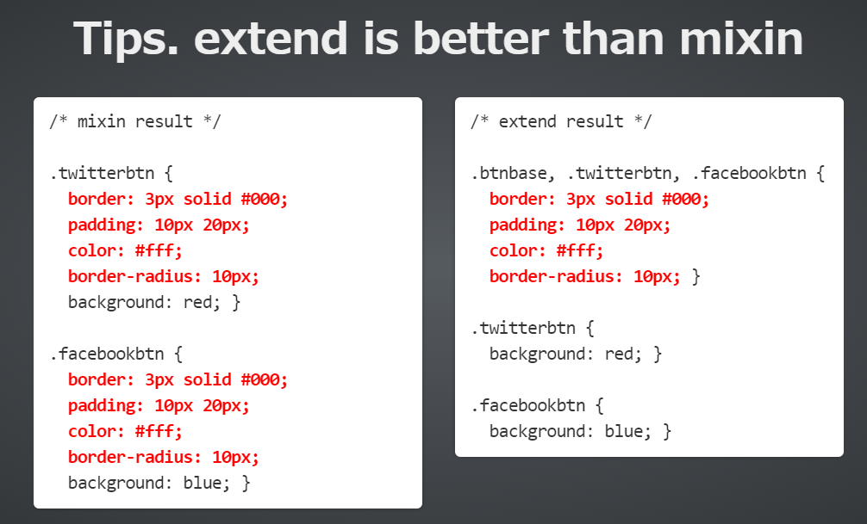
Notes:
http://codepen.io/quangsonpro/public-titles-asc/

Slide 65
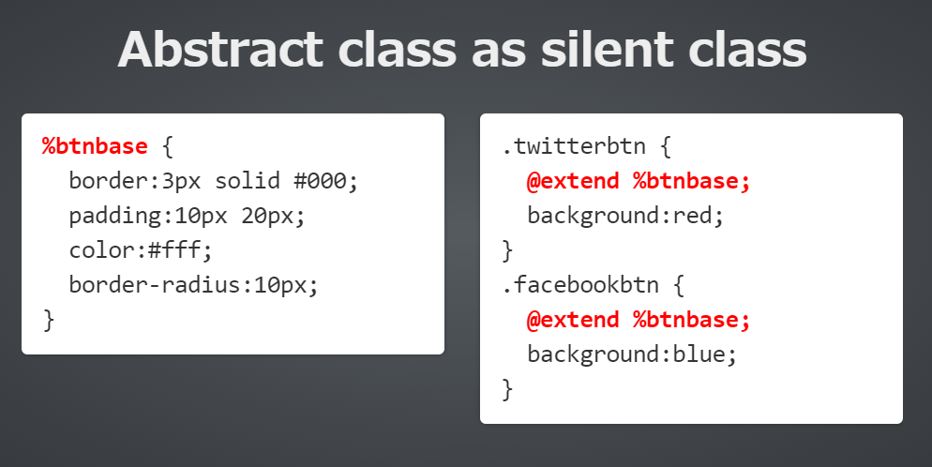
Notes:
http://codepen.io/quangsonpro/public-titles-asc/

Slide 66
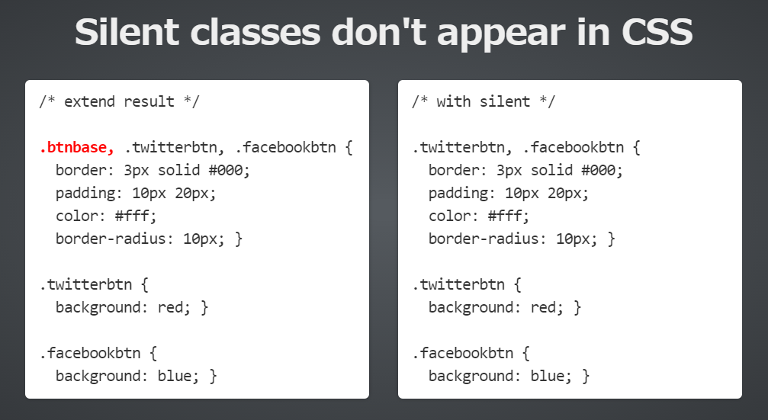
Notes:
http://codepen.io/quangsonpro/public-titles-asc/

Slide 67
Notes:
http://codepen.io/quangsonpro/public-titles-asc/

Slide 68
Sass Best Practices
Keep Things Simple
Notes:
The simple as possible. The purpose of Sass is to write cleaner more manageable CSS. Before creating any new mixins, variables, or functions, ensure that their presence will enhancconcluding point I’ll make in this post is to keep things as e development and not overcomplicate things. All Sass features are useful when used in the correct situations and in moderation.
Creating an endless list of variables without clear usage, or a complex function that is difficult to understand for anyone other than the author is not the intention and will not aid development or produce DRY CSS.

Slide 69
THANK YOU FOR YOUR ATTENTION!
6/15/15
www.qsoftvietnam.com
69

